Slide 1
Information Literacy
Top 10
Benefits for Schools
Notes:
This presentation shows ten key benefits of information literacy for schools and, more importantly, their pupils.
The ten benefits in this presentation are not listed in order of priority - the priority is for you to decide.

Slide 2
Information literacy is knowing when and why you need information, where to find it, and how to evaluate, use and communicate it in an ethical manner
(CILIP 2004)
Notes:
There are many definitions for information literacy which have been developed since the mid 70’s. This is the definition used by the Welsh Information Literacy Project and was coined by the Chartered Institute of Library and Information Professionals (CILIP). As you can see it is very applicable to the skills needed by learners in all subjects.

Slide 3
Independent Learners
10
Notes:
The first important benefit for schools is that information literacy fosters the research and critical evaluation skills required for researching, evaluating and putting information into context which is essential for independent and lifelong learning.

Slide 4
Future Growth
9
Notes:
Information (of varying quality) is increasingly abundant.
This trend will continue to shape the world today’s pupils will be working in and in order to prepare learners for the demands of the future jobs market, information literacy is a crucial skill set to develop now.
Effective decisions are based on the accurate evaluation of information you have sought. Therefore, the employment market is increasingly dependent on information literacy.

Slide 5
8
Skills Framework
Notes:
Information literacy not only supports a number of areas of the Skills Framework for 3 to 19 year-olds (such as critical thinking), it also directly delivers them.
For further information on the Skills Framework and Information Literacy, please see Information Literacy Framework for Wales, point 4.2 (available from www.welshinformationliteracy.org). The Framework highlights every learning objective for each skill area which directly relates to or supports information literacy. For example in the key skill area ‘Developing ICT,’ all of the learning objectives are based on information literacy.

Slide 6
7
Transition
Notes:
The Information Literacy Framework for Wales, Section 5 (available from www.welshinformationliteracy.org) is integrated into the Credit and Qualifications Framework for Wales and shows learning objectives at all of the CQFW levels (Entry Level 1 to level 8).
This means that there is a common understanding of information literacy expectations across the developmental scale which supports transition between key stages, sectors and institutions.

Slide 7
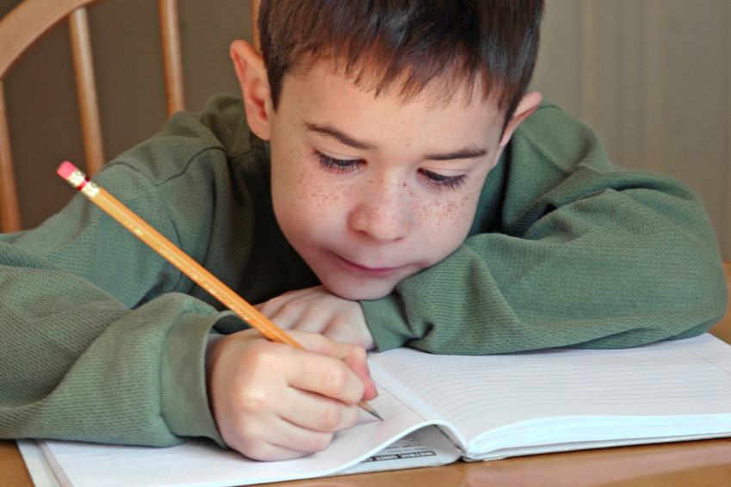
6
Literacy Skills
Notes:
Information Literacy is task oriented. Reading skills are practiced through seeking and evaluating information. Writing skills are reinforced when recording and presenting information
As students develop the skills to use library and information resources and locate relevant information, they are encouraged to practice reading in a sustainable way.
PISA defines literacy as “[...] understanding, using, reflecting on and engaging with written texts, in order to achieve one’s goals, to develop one’s knowledge and potential, and to participate in society.”(OECD 2009). Clearly then, as the Welsh Government strives to bring Wales up the PISA rankings it is important to incorporate information literacy, as its goal oriented emphasis is essential.

Slide 8
5
Digital Inclusion
Notes:
The information literate person can find and exchange information using digital means.
They are therefore digitally included and empowered to benefit from the financial, economic and social advantages that the internet can offer.

Slide 9
4
E-Safety
Notes:
In order to enable digital inclusion however, critical evaluation skills of information literacy are also essential for e-safety.
By validating authenticity and security and knowing how and when to present information, pupils are better able to protect themselves online.

Slide 10
3
Avoiding Plagiarism
Notes:
Plagiarism has become an increasingly important topic in recent years due to the abundance of information and means of accessing it.
Without sufficient information literacy skills and techniques, students are frequently open to allegations of plagiarism and the consequences can be serious.

Slide 11
2
Social Citizenship
Notes:
Information literacy is essential to developing effective citizenship skills for education and for life.
Your pupils must be able to seek and compare information and evaluate its source and content to engage in e-democracy.

Slide 12
1
Partnership
Notes:
You have the specialist expertise and resources already in house waiting to be used.
Your school librarian / schools library service librarian is trained and experienced in information literacy and can support you through paired teaching in the library. The skills, resources and support are there to help you achieve the benefits of information literacy for your classes and pupils.
Why not contact your librarian and talk about how they can support you by embedding information literacy skills in your classes next research project?

Slide 13
Want to learn more?
Contact your School Librarian or Schools Library Service Librarian
www.welshinformationliteracy.org
Notes:
Thank you. Want to learn more? Ask your School Librarian or Schools Library Service Librarian.
You can learn more about the Welsh Information Literacy Project at our website: www.welshinformationliteracy.org

