Slide 2
Supporting Colleagues To
‘Increase Library Services Used By Each Visitor’

Slide 3
Action plans
1. Project to be completed before next session:
List 3 Smart Objectives for things you will do and implement to increase uptake of services before the next session.
2. Bring to the next session:
A success story following use of ASK
A story where it all went wrong and you became wiser as a result! So we can discuss at the next session

Slide 4
Activity: Popularity of library services
List the library services in order of popularity. Most popular being 1. Score all out of 10 for user awareness. 1 being low, 10 high.

Slide 5
Activity: What can we do to raise awareness?
Discuss the services that have potential for increased use if library visitors knew about them.
Explain as a team we have to become Super Servers to engage library users

Slide 6
Activity: Server or Super Server?
Study the list of services and identify would be delivered by a Server or a Super Server

Slide 7
Super Servers ASK
Abilities - Listen and watch for clues that cues to introduce library services
Skills – Of communication
Knowledge - of library services

Slide 8
How its Used
ABILITIES to watch and listen for Visual and verbal clues – things the library user says or
does that opens the door of opportunity to introduce a library service.
SKILLS of Communication Ask the library questions – open questions to gather
Information, closed questions to clarify and confirm. Listen to their answers and watch
what they do
KNOWLEDGE of library services Know the benefits of the services – explain to the
Customer how the service will benefit them

Slide 9
Abilities – Listen and watch for clues
Verbal Clues – Something the library user says to you or someone else that gives and indication that there might be a level of interest in one of the library services
Visual Clues – Something the library user does that gives you an indication that there might be a level of interest in one of the library services
Open questions – The library user will answer with valuable information. Open questions start with the following words: Who, what, where, when and how
Closed questions – The library user will answer with a short answers which confirms or clarifies something you have asked them

Slide 10
ABILITIES - Listen For Verbal Clues To Gain Information
I have to catch 3 busses to get to the library now.
I read that the other day in my magazine.
It’s so frustrating when I’ve read all the books I’ve borrowed.
LIBRARY SERVICES
I got an iPad for my birthday.
I’ve got three grandchildren.
The church has stopped the coffee mornings now.
My eldest has just started school.

Slide 11
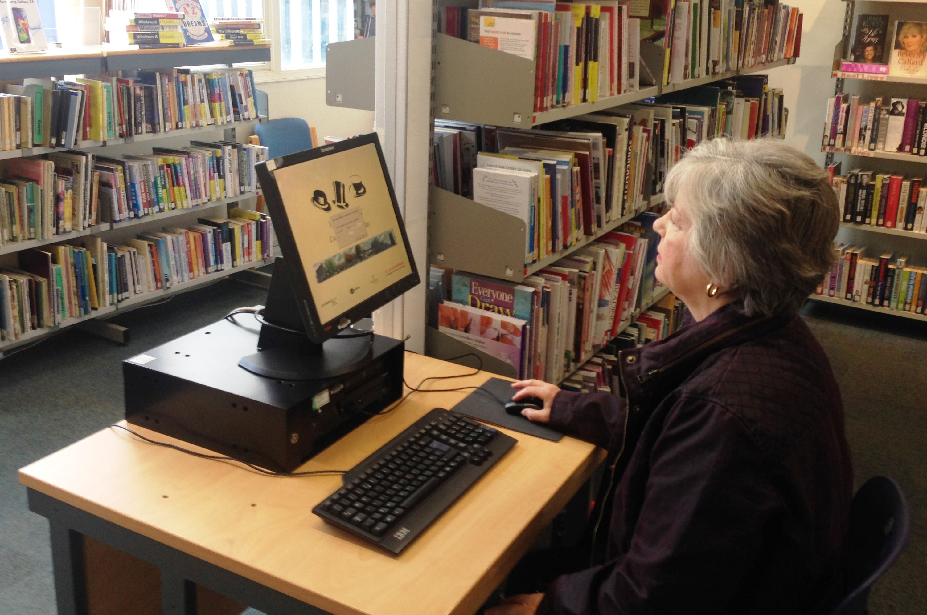
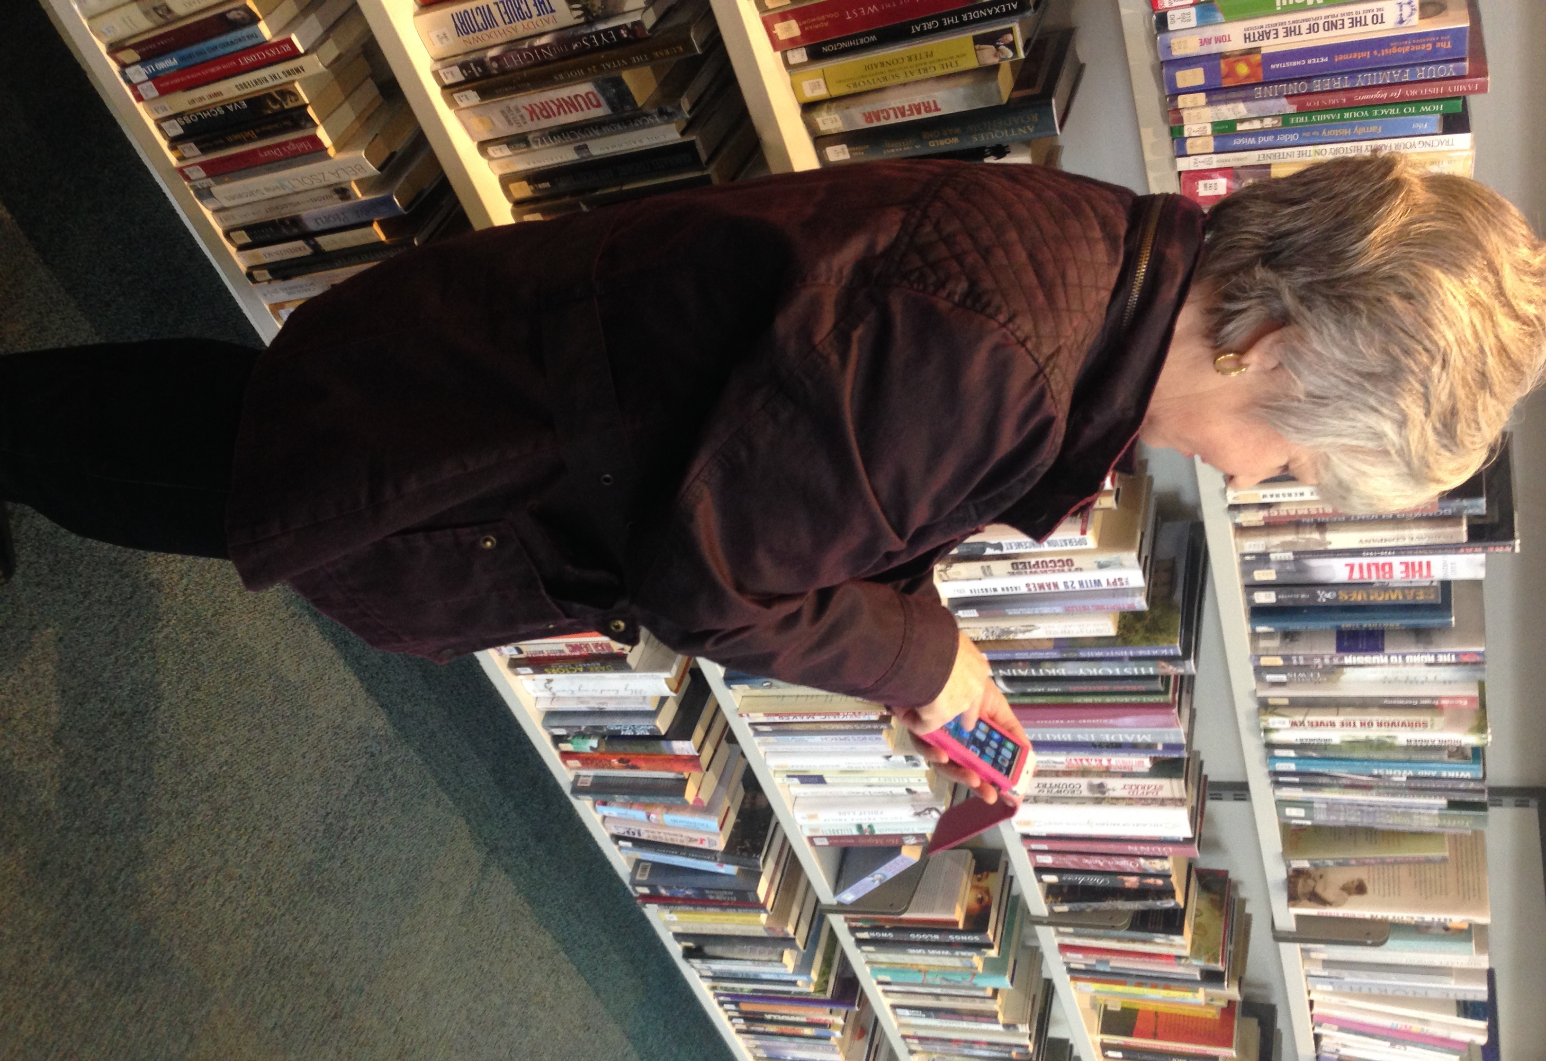
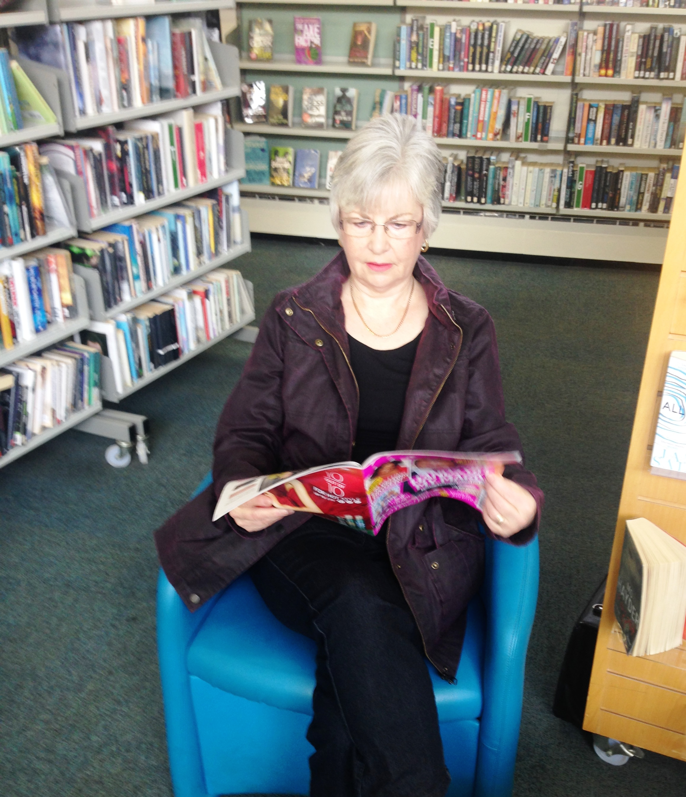
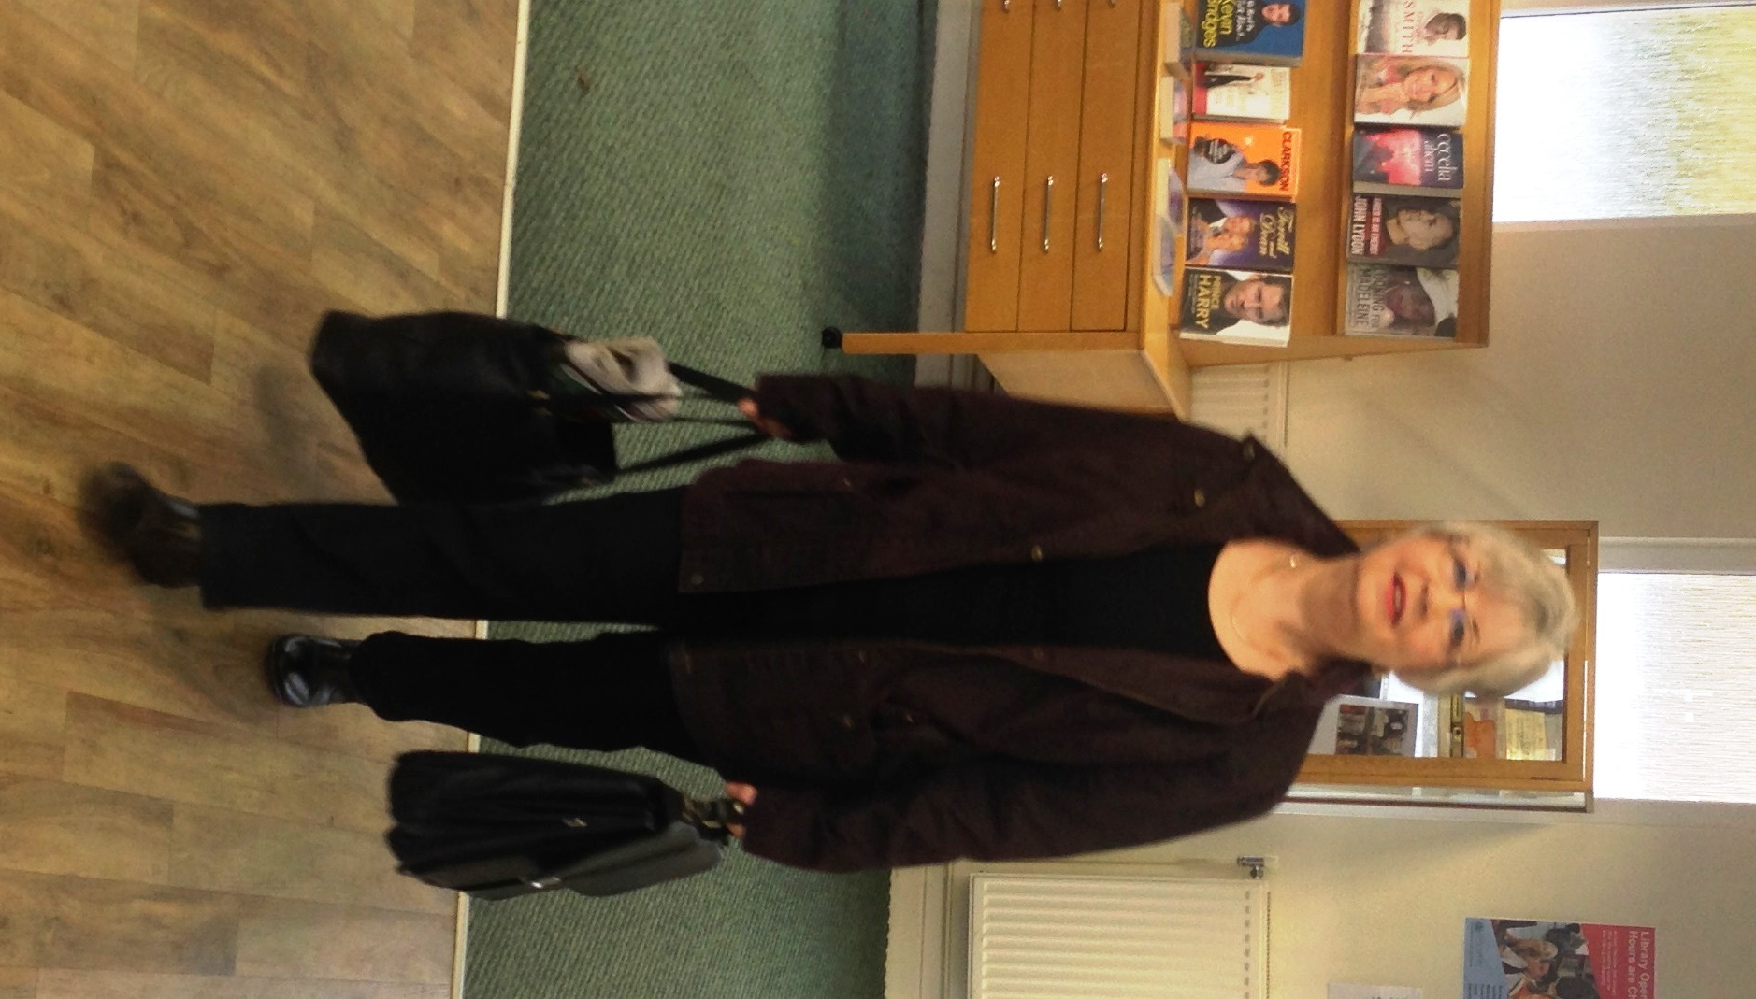
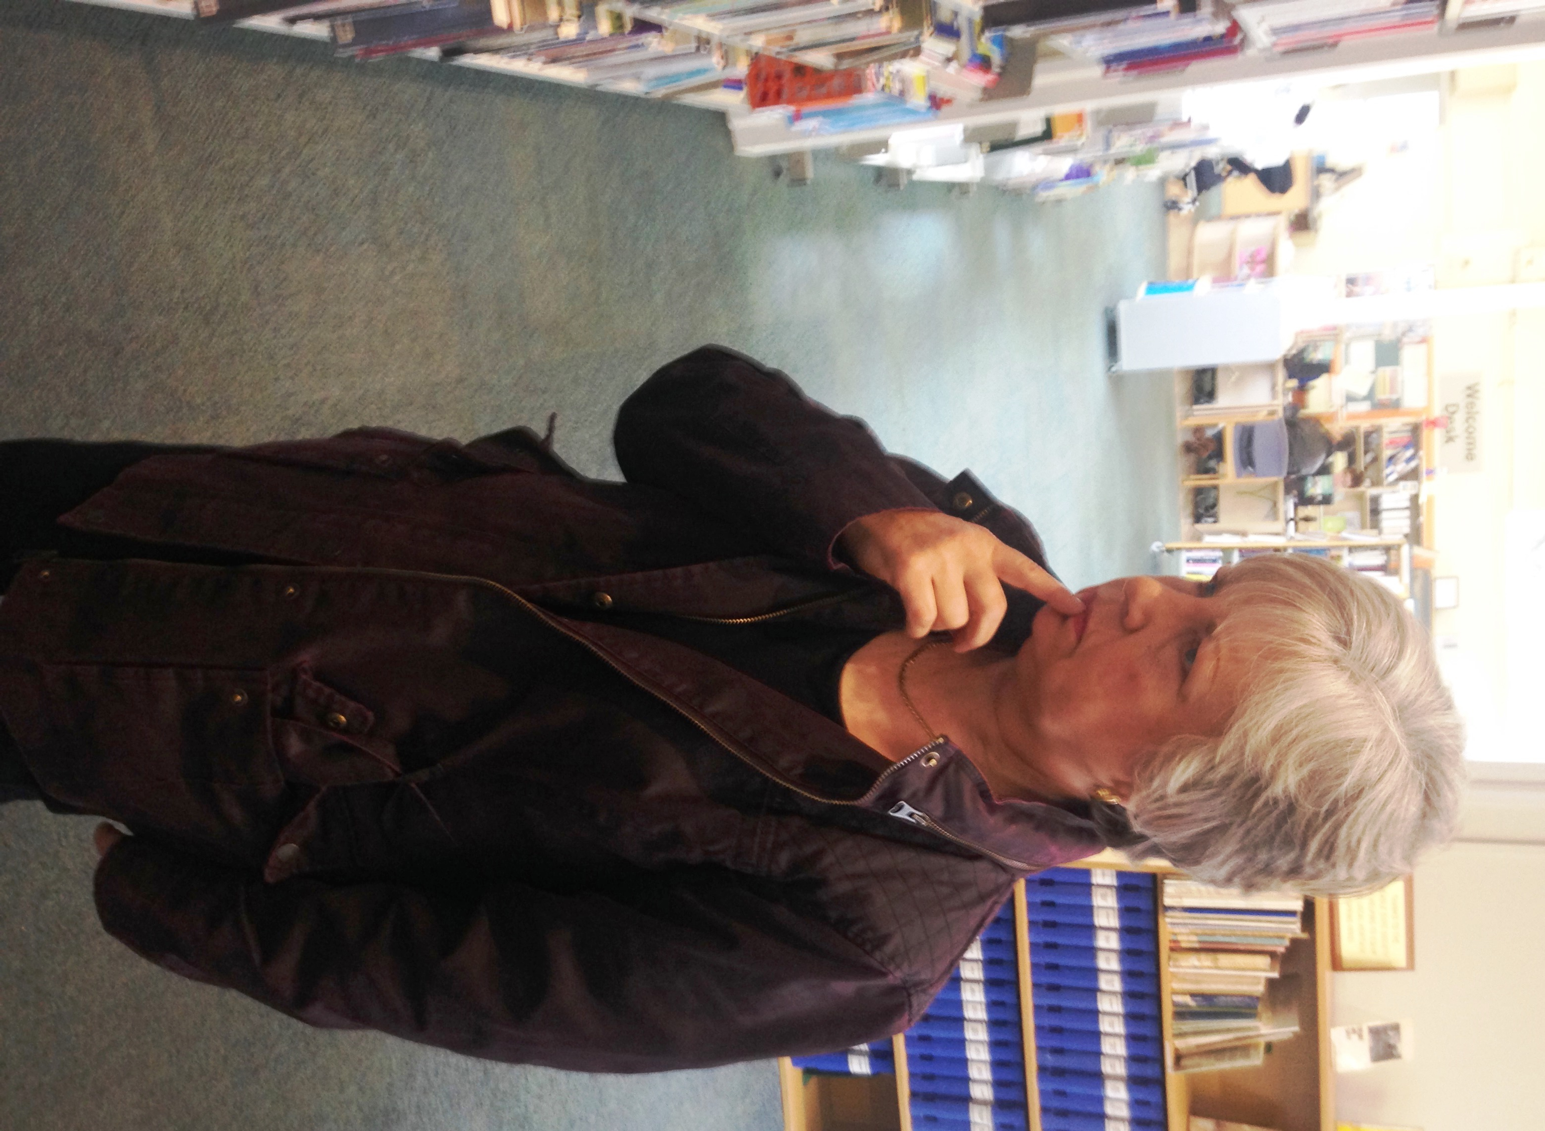
ABILITIES - Look For Visual Clues To Gain Information

Slide 12
SKILLS - Ask Open Questions To Gain Information
I have six honest serving men
They taught me all I knew.
They are WHERE, WHY, WHEN,
WHAT, HOW, and WHO.
Rudyard Kipling
What magazines do you like to read?
How often do you come to the library?
How much do your magazines and papers cost each month?
What are the main services you use?

Slide 13
SKILLS Ask Closed Questions To Confirm and Clarify
Would Could
Should Will
If Can
Is Do
If I could show you how you can save money each month on magazines, would you be interested?
Would you like to join us on one of our coffee mornings?
Do you use the download facility on your iPad?
Do you like to meet up with other people?

Slide 14
Super Server Funnel
Visual and verbal clues. See user with a new iPad
Hear user say they have and iPad
Ask open questions. What magazines do you
like to read?
How much do you spend on newspapers and
magazines each month?
Clarify with closed questions. If I could
demonstrate how you could save some
money each month on magazines and
newspapers, would you be interested?
Library Service. Introduce magazine and newspaper download

Slide 15
Activity: Introducing library services
Create open and closed questions

Slide 16
KNOWLEDGE
Knowledge is power
Know the library services and talk to the user about how the service can benefit them
Benefits – what the service will do for them, save time, save money, add value to their life

Slide 17
Activity: Ability – Library service benefits
Identify the benefits of the key library services. Do they save time, money or add value?

Slide 18
Introducing Services
To existing library users:
Watch for clues
Listen for clues
Ask them questions
Introduce services
Approach them when you see or hear a clue that presents an opportunity to introduce a service
If you are already in discussion with them and hear or see a clue, introduce the appropriate service
To non library users:
Contact local business
Contact local community groups
example mother and baby groups
Attend and set up a stall at local events –
Business networking events
Community events

Slide 19
Introducing Services To Non Library Users
To non library users:
Contact local business
Contact local community groups
example mother and baby groups
Attend and set up a stall at local events –
Business networking events
Community events

Slide 20
Thank you
Enjoy a
Merry and Peaceful Christmas!

